Slide 1
Data Mining & Knowledge Discovery
IME 672
Lecture 3

Slide 2
Data Preprocessing

Slide 3
Why Preprocess the Data?
Low-quality data will lead to low-quality mining results
Major issues with Data Quality
Accuracy: correct or wrong, accurate or not, noisy, …
Completeness: not recorded, unavailable, …
Consistency: some modified but some not, dangling, …
Timeliness: timely update?
Believability: how trustable the data are correct?
Interpretability: how easily the data can be understood?

Slide 4
Major Tasks in Data Preprocessing
Data cleaning
Fill in missing values, smooth noisy data, identify or remove outliers, and resolve inconsistencies
Data integration
Integration of multiple databases, data cubes, or files
Data reduction
Dimensionality reduction
Numerosity reduction
Data transformation and data discretization
Normalization
Concept hierarchy generation

Slide 5
Data Cleaning
Data in the Real World is Dirty: Lots of potentially incorrect data, e.g., instrument faulty, human or computer error, transmission error
incomplete: lacking attribute values, lacking certain attributes of interest, or containing only aggregate data
e.g., Occupation = “ ” (missing data)
noisy: containing noise, errors, or outliers
e.g., Salary = “−10” (an error)
inconsistent: containing discrepancies in codes or names, e.g.,
Age = “42”, Birthday = “03/07/2010”
Was rating “1, 2, 3”, now rating “A, B, C”
intentional: (e.g., disguised missing data)
Jan. 1 as everyone’s birthday?

Slide 6
How to Handle Missing Data?
Ignore the tuple: usually done when class label is missing (when doing classification)
Fill in the missing value manually: tedious + infeasible
Fill in it automatically with
a global constant : e.g., “unknown”, a new class?!
the attribute mean / median
the attribute mean for all samples belonging to the same class
the most probable value: regression, inference-based such as Bayesian formula or decision tree

Slide 7
How to Handle Noisy Data?
Binning
first sort data and partition into (equal-frequency) bins
then one can smooth by bin means, smooth by bin median, smooth by bin boundaries, etc.
Regression
smooth by fitting the data into regression functions
Clustering
detect and remove outliers
Combined computer and human inspection
detect suspicious values

Slide 8
Data Integration
Data integration
Combines data from multiple sources into a coherent store
Schema integration: e.g., A.cust-id ≡ B.cust-#
Integrate metadata from different sources
Entity identification problem:
How can equivalent real-world entities from multiple data sources be matched up?
Detecting and resolving data value conflicts
For the same real world entity, attribute values from different sources are different
Possible reasons: different representations, different scales, e.g., metric vs. British units

Slide 9
Handling Redundancy in Data Integration
Redundant data occurs often when integration of multiple databases
Object identification: The same attribute or object may have different names in different databases
Derivable data: One attribute may be a “derived” attribute in another table, e.g., annual revenue
Redundant attributes can be detected by correlation and covariance analysis
Careful integration of the data from multiple sources may help reduce/avoid redundancies and inconsistencies and improve mining speed and quality

Slide 10
Correlation Analysis (Nominal Data)
Χ² (chi-square) test
The larger the Χ² value, the more likely the variables are related
Correlation does not imply causality
# of hospitals and # of car-theft in a city are correlated
Both are causally linked to the third variable: population

Slide 11
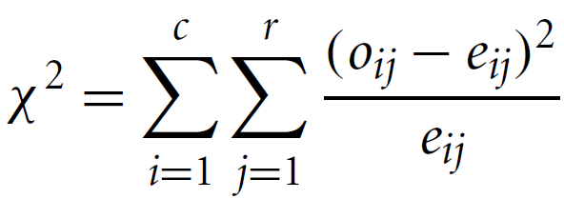
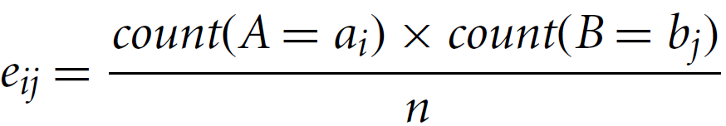
Correlation Analysis (Nominal Data)
Correlation relationship between two attributes, A and B
A has c distinct values and B has r
Contingency table: c values of A are the columns and r values of B the rows
(A_{i} ,B_{j}): joint event that attribute A takes on value a_{i} and attribute B takes on value b_{j}
o_{ij} = observed frequency, e_{ij} = expected frequency

Slide 12
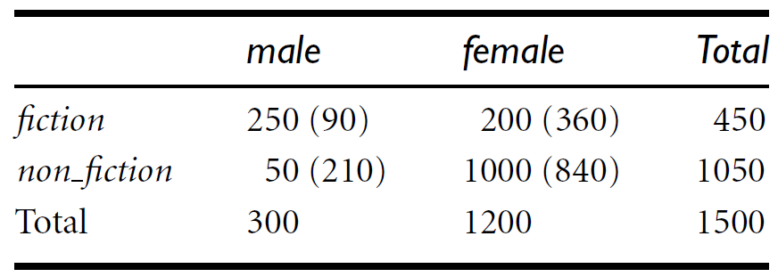

Example
A group of 1500 people was surveyed
Gender of each person was noted
Preferred type of reading: fiction or nonfiction

Slide 13
Correlation Analysis (Numeric Data)
Correlation coefficient (also called Pearson’s product moment coefficient)
where n is the number of tuples, and are the respective means of A and B, σ_{A} and σ_{B} are the respective standard deviation of A and B, and Σ(a_{i}b_{i}) is the sum of the AB cross-product
-1 <= r_{A,B} <= +1
If r_{A,B} > 0, A and B are positively correlated (A’s values increase as B’s). The higher, the stronger correlation.
r_{A,B} = 0: independent; r_{AB} < 0: negatively correlated

Slide 14
Data Reduction Strategies
Objective: Obtain a reduced representation of the data set that is much smaller in volume but yet produces the same (or almost the same) analytical results
Why? — Complex data analysis may take a very long time to run on the complete data set
Data reduction strategies
Dimensionality reduction
Wavelet transforms
Principal Components Analysis (PCA)
Attribute/Feature subset selection, feature creation
Numerosity reduction
Regression and Log-Linear Models
Histograms, clustering, sampling
Data cube aggregation
Data compression

